Slide 1
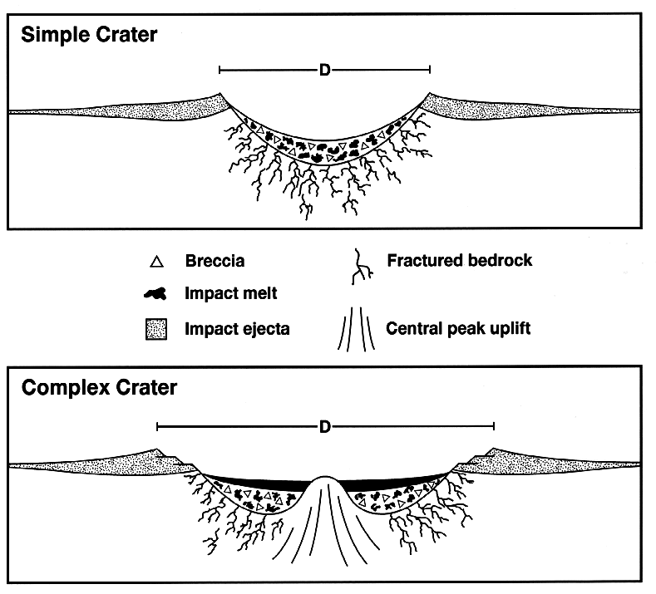
Simple Craters

Slide 2
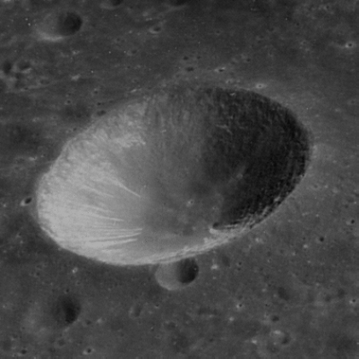
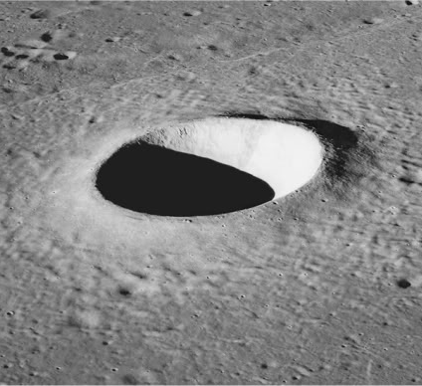
Simple Craters
Notes:
Moon

Slide 3
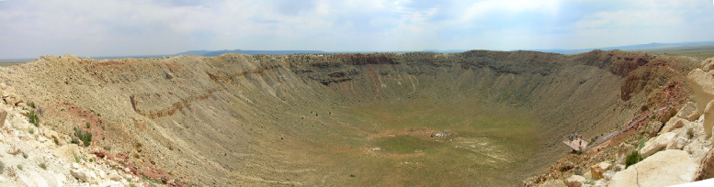
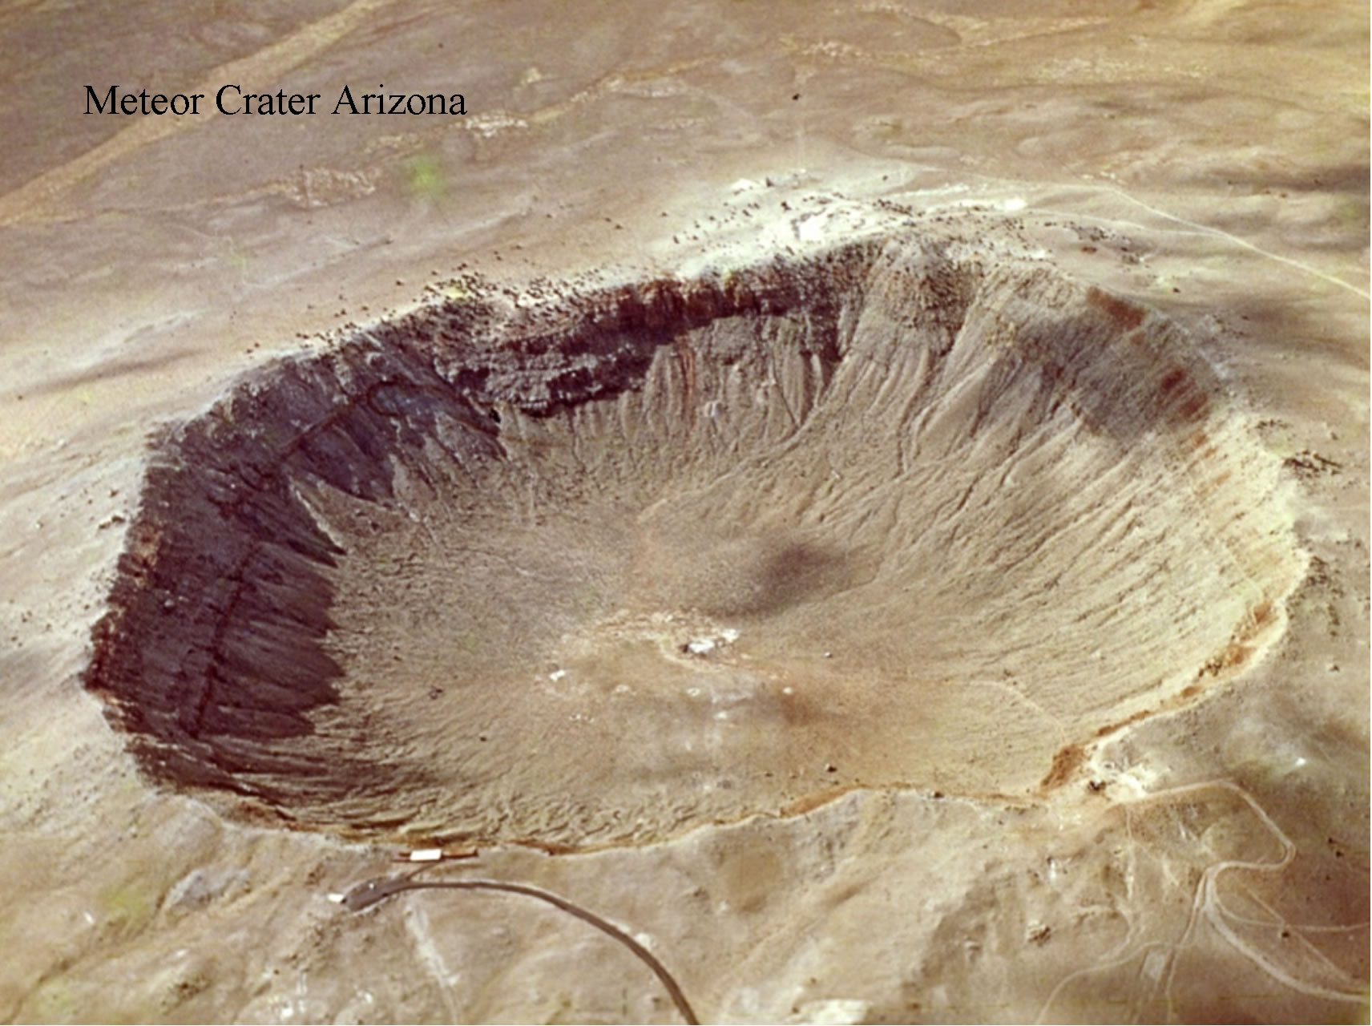

Slide 4
Complex Craters

Slide 5
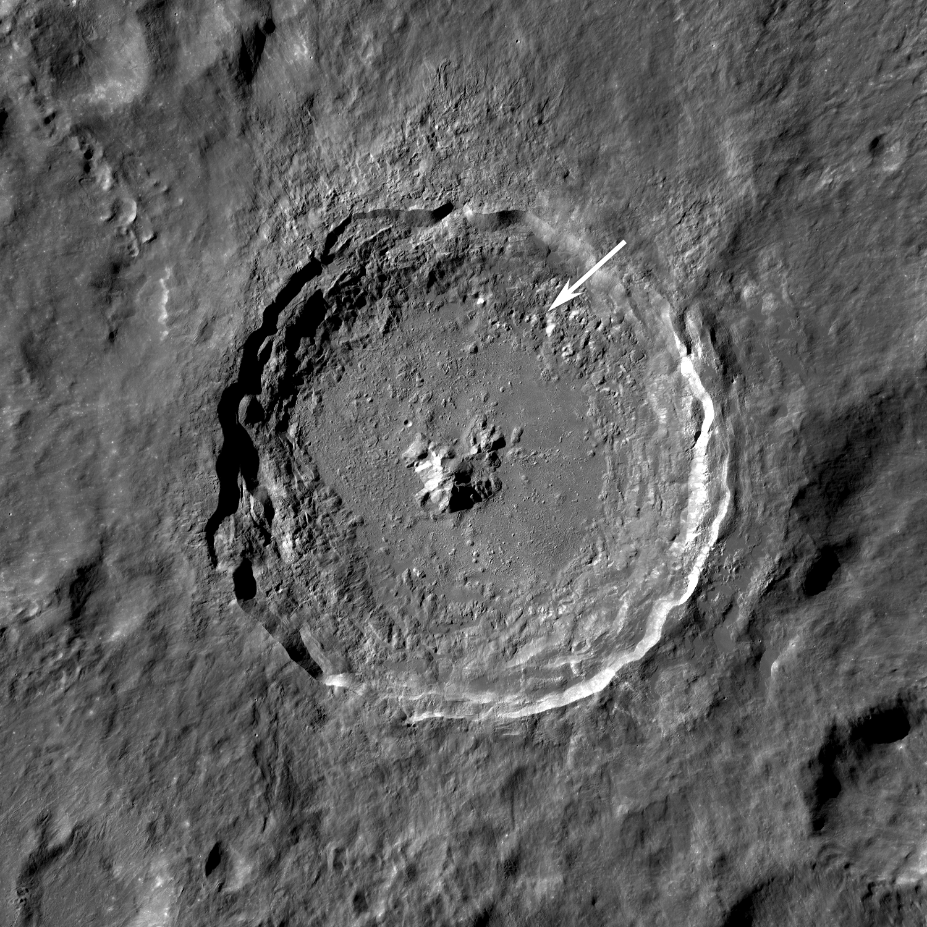
Complex Craters (Central Peak)
Notes:
Moon (Tycho)

Slide 6
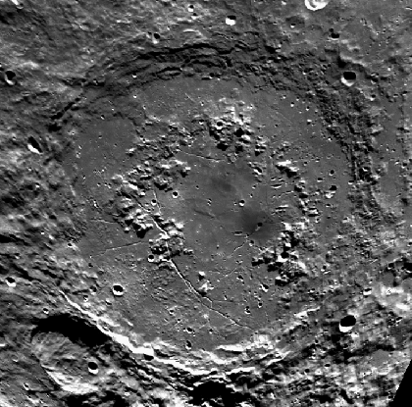
Complex Craters (Peak Ring)
Notes:
Moon

Slide 7
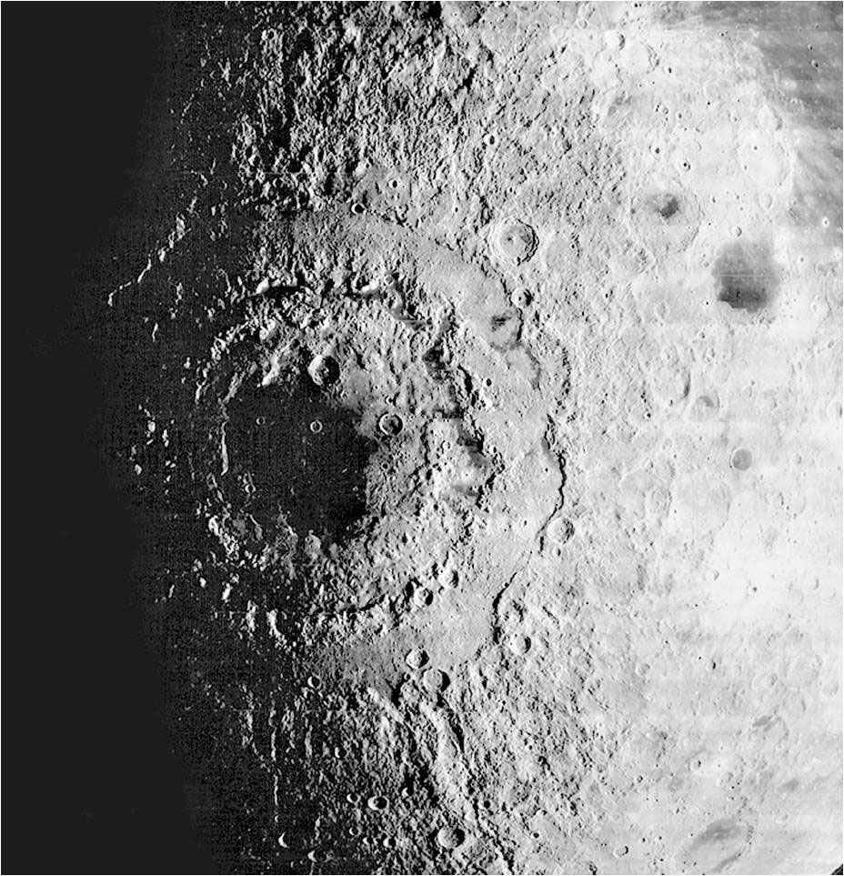
Complex Craters (Multi-Ring)
Notes:
Moon

Slide 8
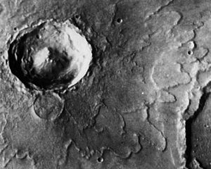
Rampart Craters
Notes:
Mars

Slide 9
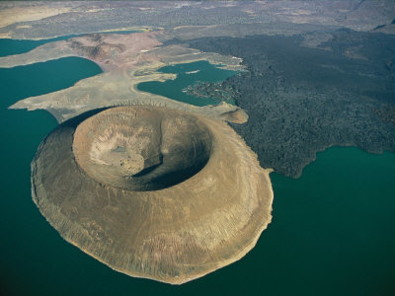
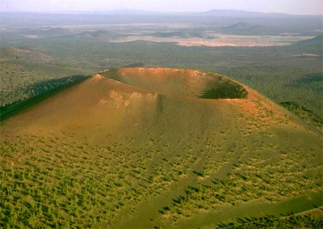
Volcanic Craters
Notes:
Left one is in Kenya. Right one is Sunset Crater in Arizona.

